Slide 1

Lecture 2 Cyber Security Essentials 20CYS114
-Saurabh Shrivastava
TIFAC Core in Cyber Security
Amrita Vishwa Vidyapeetham

Slide 2
Browser Interaction with Web Server
Encryption
Key exchange
Cipher Suite
Certificate
Integrity

Slide 3
Encryption
Symmetric
Asymmetric

Slide 4
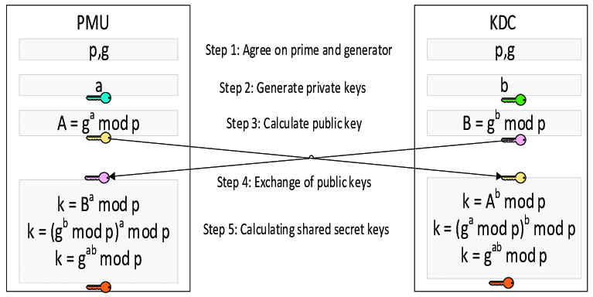
Diffie Hellman Key Exchange

Slide 5
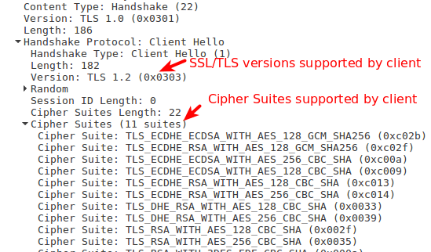
Client Hello

Slide 6
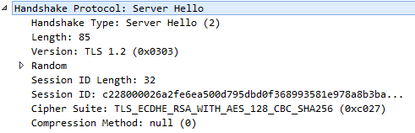
Server Hello

Slide 7
Authentication
Certificates
Credentials

Slide 8
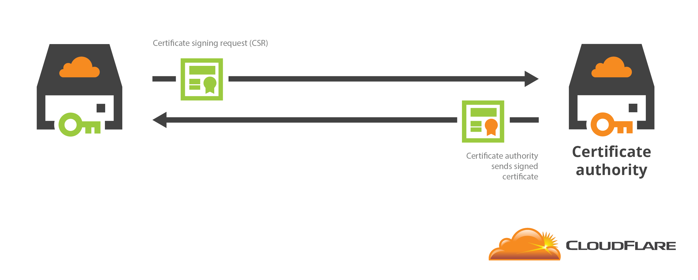
Certificate Signing

Slide 9
Integrity
Hash
MAC

Slide 10
References:
https://www.linuxbabe.com/security/ssltls-handshake-process-explained-with-wireshark-screenshot
https://en.wikipedia.org/wiki/Cipher_suite

